Slide 1
CHAPTER 7
Symmetric Matrices and Quadratic Forms

Slide 2
Chapter 7 Symmetric Matrices and Quadratic Forms
§ 7.1 Diagonalization of Symmetric Matrices
§ 7.2 Quadratic Forms
§ 7.4 SVD Decomposition

Slide 3


§7.1 Diagonalization of Symmetric Matrices
What is Symmetric Matrices?
  A symmetric matrix is a matrix A such that A^{T} = A.
Example 1：
Symmetric:
Nonsymmetric:

Slide 4
§7.1 Diagonalization of Symmetric Matrices
Properties of Symmetric Matrices
  Such a matrix is necessarily square.
  Its main diagonal entries are arbitrary.
  Its other entries occur in pairs- on opposite sides of the main diagonal.

Slide 5


Review ： the diagonalization process.
Example ： If possible, diagonalize the matrix
Solution： The characteristic equation of A is
Standard calculations produce a basis for each eigenspace:

Slide 6
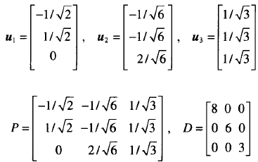
Normailize v1, v2 and v3 to produce the unit eigenvectors
Let
Then A = PDP⁻¹. Since P is square and has orthonormal columns, P is an orthogonal matrix, and P⁻¹ is simply P^{T}.

Slide 7

§7.1 Diagonalization of Symmetric Matrices
Theorem 1
If A is symmetric, then any two eigenvectors from different eigenspaces are orthogonal.
Proof： Let v₁ and v₂ be eigenvectors that correspond to
distinct eigenvalues, say, λ₁ and λ₂. To show that v₁·v₂ = 0,
compute
∴
∵
∴

Slide 8


A matrix A is said to be orthogonally diagonalizable if there are an orthogonal matrix P (with P⁻¹ = P^{T}) and a diagonal matrix D such that
To orthogonally diagonalize an n×n matrix, we must find n linearly independent and orthonormal eigenvectors. If A is orthogonally diagonalizable as in (1), then

Slide 9
§7.1 Diagonalization of Symmetric Matrices
Theorem 2
An n×n matrix A is orthogonally diagonalizable if and only if A is symmetric matrix.
Theorem 2 shows that, every symmetric matrix is orthogonally diagonalizable.

Slide 10



Example：Orthogonally diagonalize the matrix
Its characteristic equation is
Solution： Compute to produce bases for the eigenspaces:
Although v₁ and v₂ are linearly independent, they are not
orthogonal.

Slide 11


Recall from Section 6.2 that the projection of v₂ onto v₁ is
and the component of v₂ orthogonal to v₁ is
Then {v₁,z₂} is an orthogonal set in the eigenspace for λ = 7.
Since the eigenspace is two-dimensional (with basis v₁, v₂), the orthogonal set {v₁,z₂} is an orthogonal basis for the eigenspace.

Slide 12
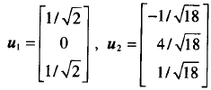

Normalizing v1 and z2, we obtain the following orthonormal
basis for
the eigenspace for λ = 7:
An orthonormal basis for the eigenspace for λ = -2 is:

Slide 13

By Theorem 1, u₃ is orthogonal to the other eigenvectors
u₁ and u₂. Hence {u₁,u₂,u₃} is an orthonormal set.
Let
Then P orthogonally diagonalizes A, and A = PDP⁻¹.

Slide 14
§7.1 Diagonalization of Symmetric Matrices
The Spectral Theorem
Theorem 3 The Spectral Theorem for Symmetric Matrices
An n×n symmetric matrix A has the following properties:
a. A has n real eigenvalues, counting multiplicities.
b. The dimension of the eigenspace for each eigenvalue λ equals the multiplicity of λ as a root of the characteristic equation.
c. The eigenspaces are mutually orthogonal, in the sense that eigenvectors corresponding to different eigenvalues are orthogonal.
d. A is orthogonally diagonalizable.

Slide 15


§7.1 Diagonalization of Symmetric Matrices
Spectral Decomposition
Suppose A = PDP⁻¹, where the columns of P are orthonormal eigenvectors u₁,…,u_{n} of A and the corresponding eigenvalues λ₁,…, λ_{n} are the diagonal matrix D. Then, since P⁻¹ = P^{T},

Slide 16

Using the column-row expansion of a product, we can write
This representation of A is called a spectral decomposition of A because it breaks up A into piece determined by the spectrum (eigenvalues) of A.

Slide 17


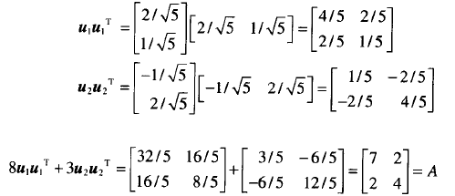
Example ：Construct a spectral decomposition of the matrix A that has the orthogonal diagonalization
Solution：Denote the columns of P by u₁ and u₂. Then
To verify this decomposition of A, compute
and

Slide 18
§7.2 Quadratic Forms
1. Definition of Quadratic Forms
2. Change of Variable in a Quadratic Form
3. A Geometric View of Principal Axes
4. Classifying Quadratic Forms

Slide 19
§7.2 Quadratic Forms
1. Definition of Quadratic Forms
A quadratic form on R^{n} is a function Q defined on R^{n} whose value at a vector x in R^{n} can be computed by an expression of the form Q(x) = x^{T}Ax, where A is an nxn symmetric matrix.
The matrix A is called the matrix of the quadratic form.

Slide 20




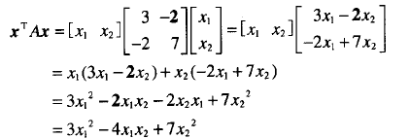
Example ：Let Compute x^{T}Ax for the following matrices:
Solution：
b. There are two -2 entries in A.

Slide 21

Example ：For x in R³, let
Write this quadratic form as x^{T}Ax.
Solution：The coefficient of go on the
diagonal of A.
To make A symmetric, the coefficient of x_{i}x_{j} for i≠j must be split evenly between the (i, j)- and (j, i) –entries in A. The coefficient of x₁x₃ is 0.

Slide 22




Example ： Let
Compute the value of Q(x) for x =
Solution：
and

Slide 23
§7.2 Quadratic Forms
2. Change of Variable in a Quadratic Form
If x represents a variable vector in R^{n}, then a change of
variable is an equation of the form
x = Py or y = P⁻¹x
where P is an invertible matrix and y is a new variable
vector in R^{n}. Here y is the coordinate vector of x relative to
the basis of R^{n} determined by the columns of P.
If the change of variable is made in a quadratic form
x^{T}Ax, then

Slide 24


Example ： Make a change of variable that transforms the quadratic form into a quadratic form with no cross-product term.
Solution： The matrix of the quadratic form is
Orthogonally diagonalize A:

Slide 25



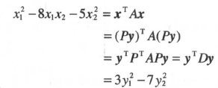
These vectors are orthogomal and so provide an orthonormal basis for R². Let
Then A = PDP⁻¹ and D = P⁻¹AP = P^{T}AP.
A suitable change of variable is
Then

Slide 26



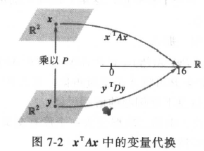
The meaning of the equality of quadratic forms:
eg. compute Q(x) for x = (2,-2).

Slide 27
§7.2 Quadratic Forms
Theorem 4 The Principal Axes Theorem
Let A be an n*n symmetric matrix. Then there is an
orthogonal change of variable, x = Py, that transforms
the quadratic form x^{T}Ax into a quadratic form y^{T}Dy with
no cross-product term.
The columns of P in the theorem are called the principal axes of the quadratic form X^{T}AX.

Slide 28
§7.2 Quadratic Forms
3. A Geometric View of Principal Axes
Suppose Q(x) = x^{T}Ax, where A is an invertible 2*2
symmetric matrix, and let c be a constant. It can be show
that the set of all x in R² that satisfy
X^{T}AX = c
either corresponding to an ellipse (circle), a hyperbola, two intersecting lines, or a single point, or contains no points at all.
If A is a diagonal matrix, the graph is in standard position.
If A is not a diagonal matrix, the graph is rotated out of standard position.

Slide 29
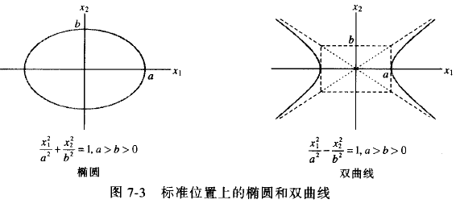

Slide 30
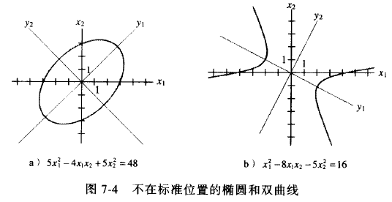

Slide 31

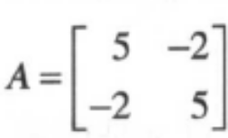
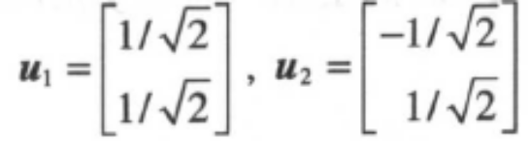
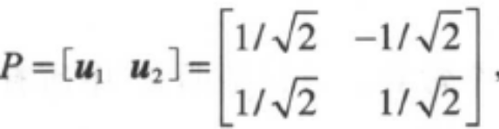

§7.2 Quadratic Forms
Example ：The ellipse in Fig 7.4 (a) is the graph of the equation
Find a change of variable that removes the cross-product term from the equation.
Solution The matrix of the quadratic form is . The eigenvalues of A turn out to be 3 and 7, with corresponding unit eigenvectors
Let Then P orthogonally diagonally diagonalizes A, so the change of variable x=Py product the quadratic form
.

Slide 32
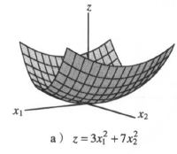
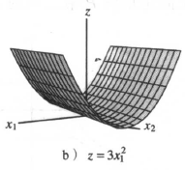
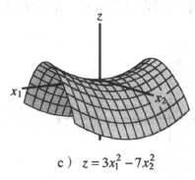
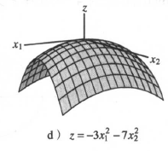
§7.2 Quadratic Forms
4. Classifying Quadratic Forms

Slide 33
§7.2 Quadratic Forms
Definition
A quadratic form Q is:
a. positive definite if Q(x) > 0 for all x≠0.
b. negative definite if Q(x) < 0 for all x≠0.
c. indefinite if Q(x) assumes both positive and negative values.

Slide 34
§7.2 Quadratic Forms
Theorem 5 Quadratic Forms and Eigenvalues
Let A be an n×n symmetric matrix. Then a quadratic form x^{T}Ax is:
a. positive definite if and only if the eigenvalues of A are all positive.
b. negative definite if and only if the eigenvalues of A are all negative
c. indefinite if and only if A has both positive and negative eigenvalues.

Slide 35
Proof ：By the Principal Axes Theorem, there exists an orthogonal change of variable x=Py such that
where λ₁, … , λ_{n} are the eigenvalues of A. Since P is invertible, there is a one-to-one correspondence between all nonzero x and all nonzero y. Thus the values of Q(x) for x≠0 coincide with the values of the expression on the right side of (4), with is obviously controlled by the signs of the eigenvalues
λ₁, … , λ_{n} , in the three ways described in the theorem.

Slide 36
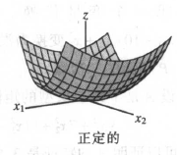
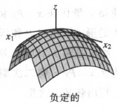
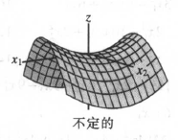
§7.2 Quadratic Forms

Slide 37

Example ： Is Q(x) positive definite?
Solution： Because of all the plus signs, the form “looks” positive definite. But the matrix of the form is
and the eigenvalues of A turn out to be 5,2, and -1.
So Q is an indefinite quadratic.

